Slide 1
PMG COVID-19 Survey - Restaurant Industry Focus
What recommendations would you make to a restaurant owner to help them remain competitive during the pandemic?
Andrew Siqueira

Slide 2
Prior to AND Since COVID 19, on average, how frequently did you do the following?
Q1. Dine in at a restaurant
Q2. Order takeout or delivery from a restaurant
Q3. Order/receive food delivery boxes
Q4. Pickup ready meals from the grocery store
Q5. Pickup meal kits from the grocery store
Q6. Had grocery delivery or curbside pickup

Slide 3
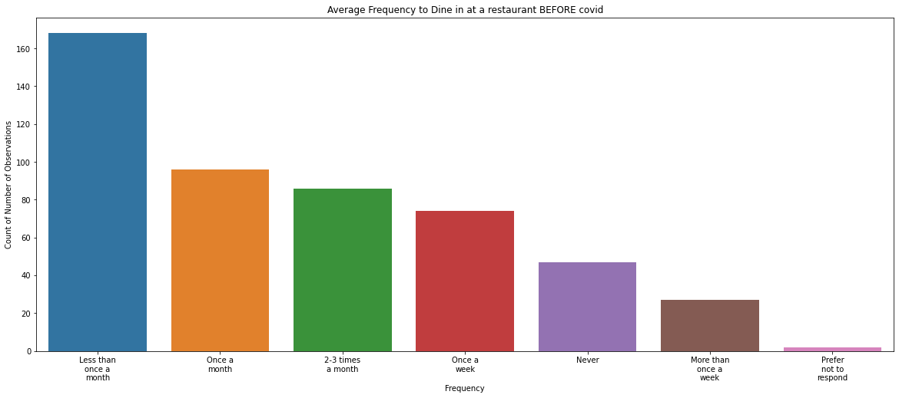
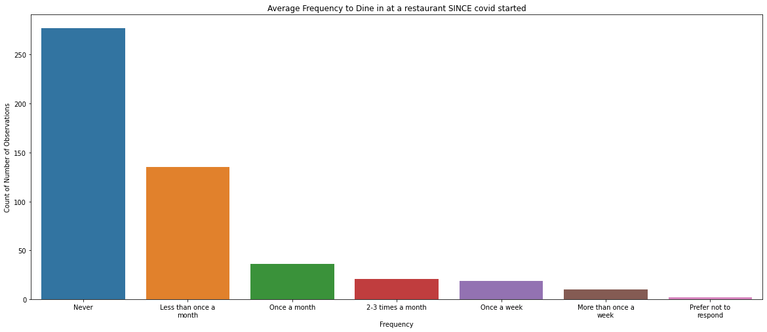
Prior to COVID 19, How frequently did you Dine in at a restaurant?
Since COVID 19, How frequently did you Dine in at a restaurant?

Slide 4
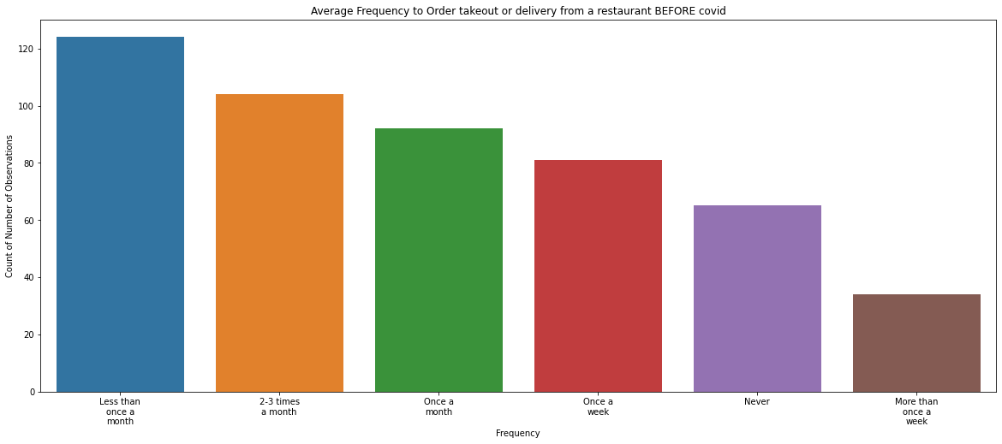
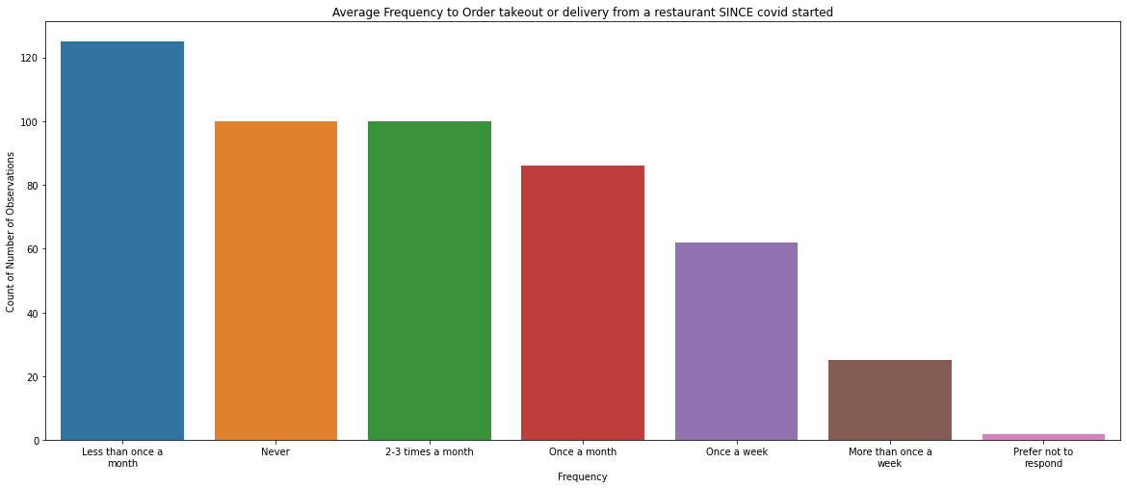
Prior to COVID 19, How frequently did you Order takeout or delivery from a restaurant?
Since COVID 19, How frequently did you Order takeout or delivery from a restaurant?

Slide 5
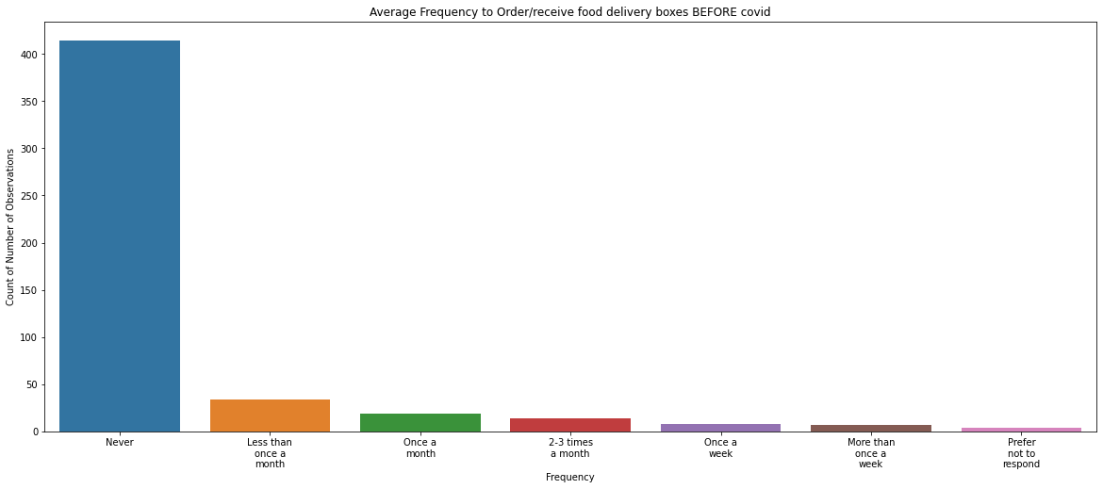
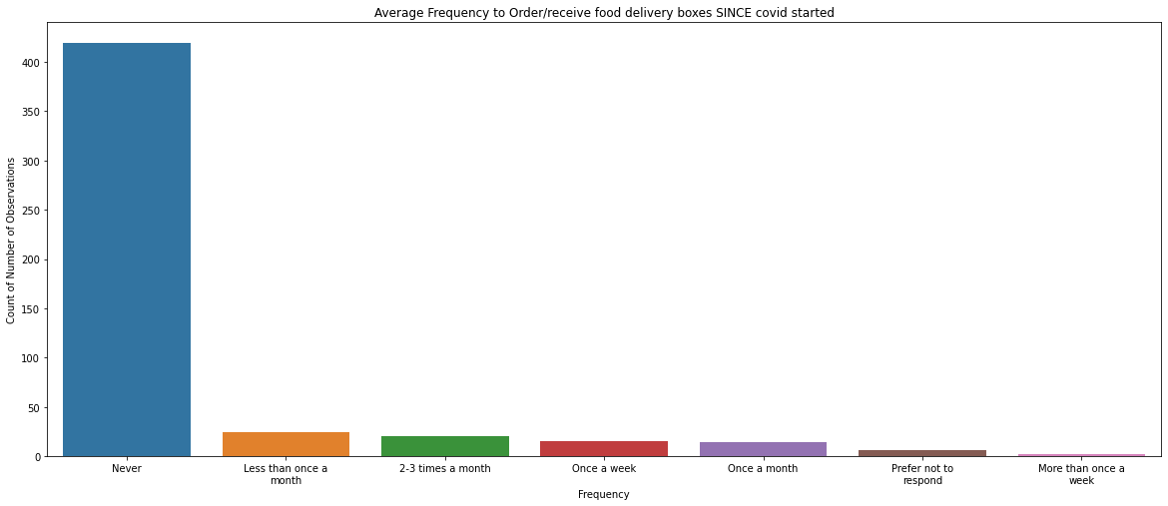
Prior to COVID 19, How frequently did you Order/receive food delivery boxes?
Since COVID 19, How frequently did you Order/receive food delivery boxes?

Slide 6
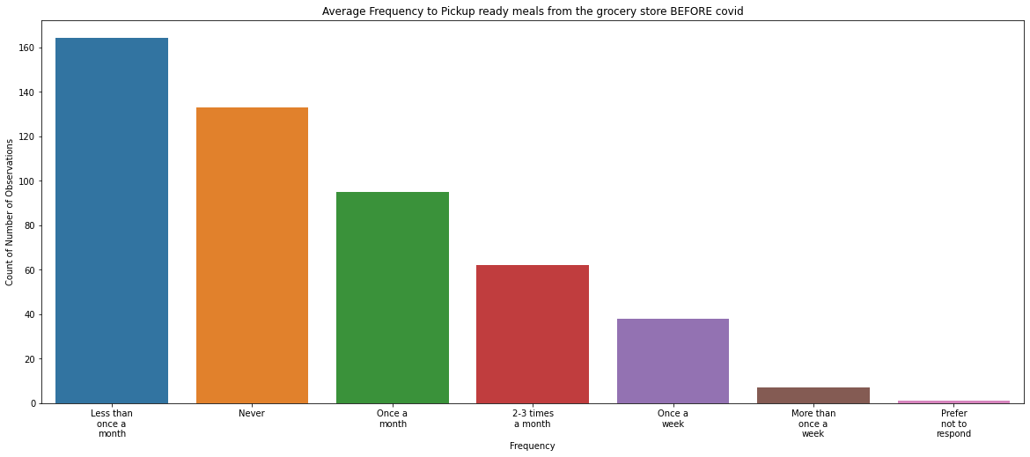
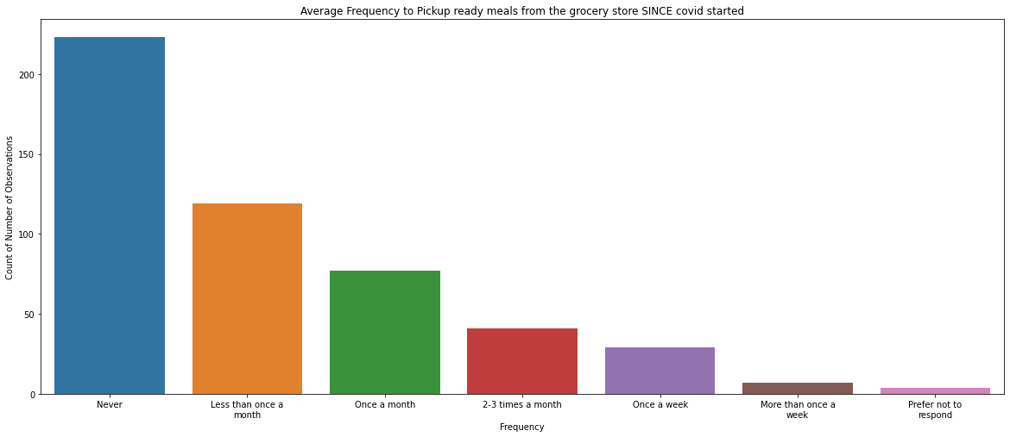
Prior to COVID 19, How frequently did you Pickup ready meals from the grocery store?
Since COVID 19, How frequently did you Pickup ready meals from the grocery store?

Slide 7
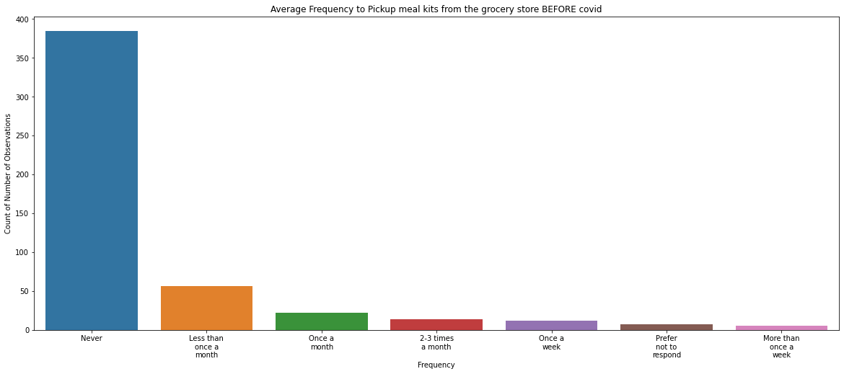
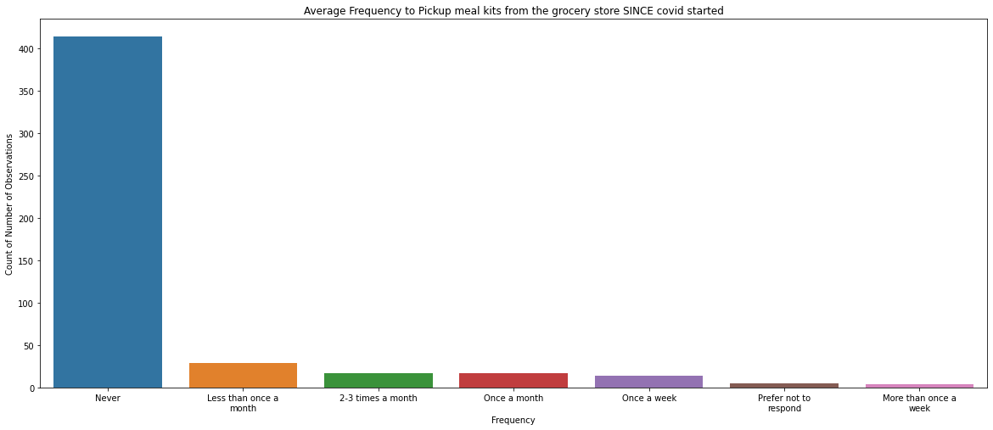
Prior to COVID 19, How frequently did you Pickup meal kits from the grocery store?
Since COVID 19, How frequently did you Pickup meal kits from the grocery store?

Slide 8
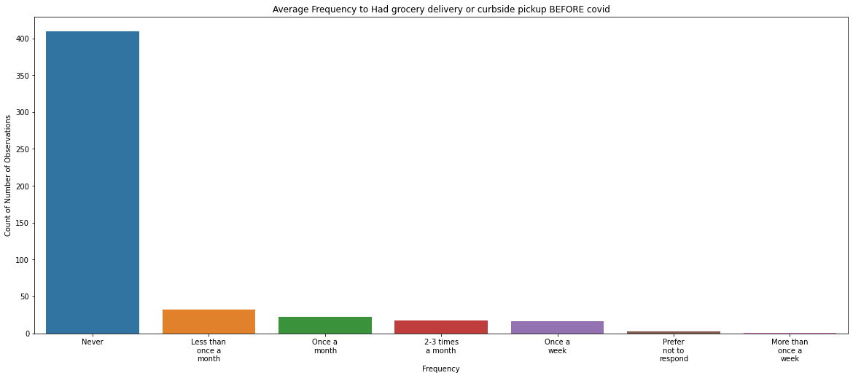
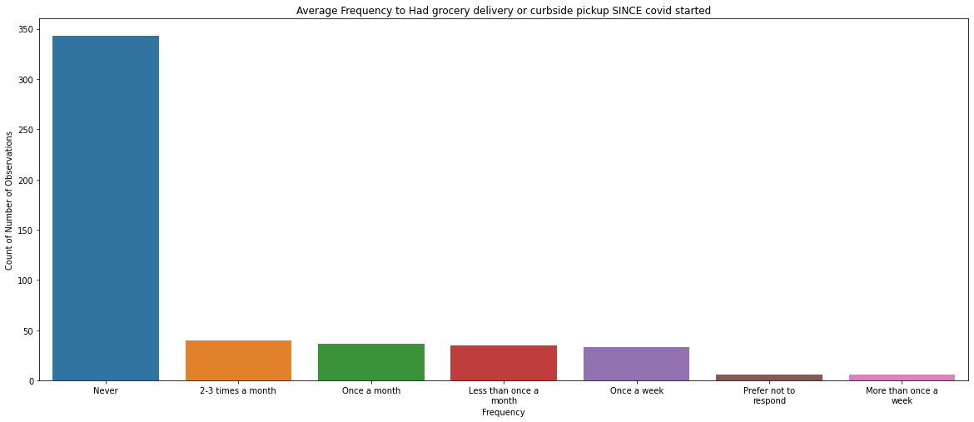
Prior to COVID 19, How frequently did you Had grocery delivery or curbside pickup?
Since COVID 19, How frequently did you Had grocery delivery or curbside pickup?

Slide 9
How comfortable would you be dining at a restaurant via the following today?
Q1. Indoors
Q2. Outdoors
Q3. Delivery
Q4. Takeout

Slide 10
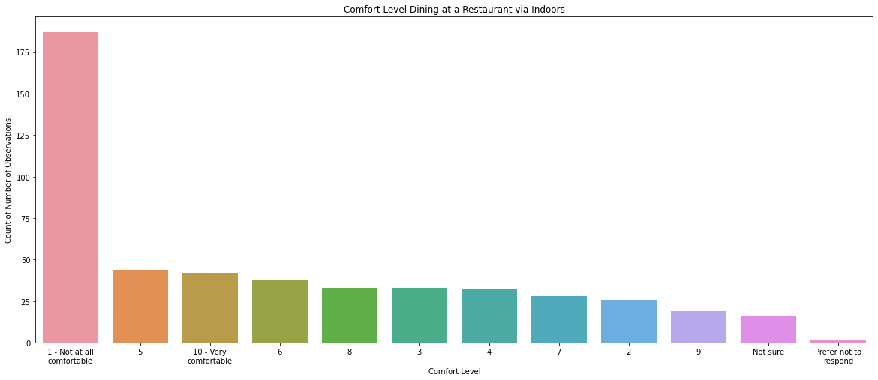
How comfortable would you be dining at a restaurant via Indoors TODAY?

Slide 11
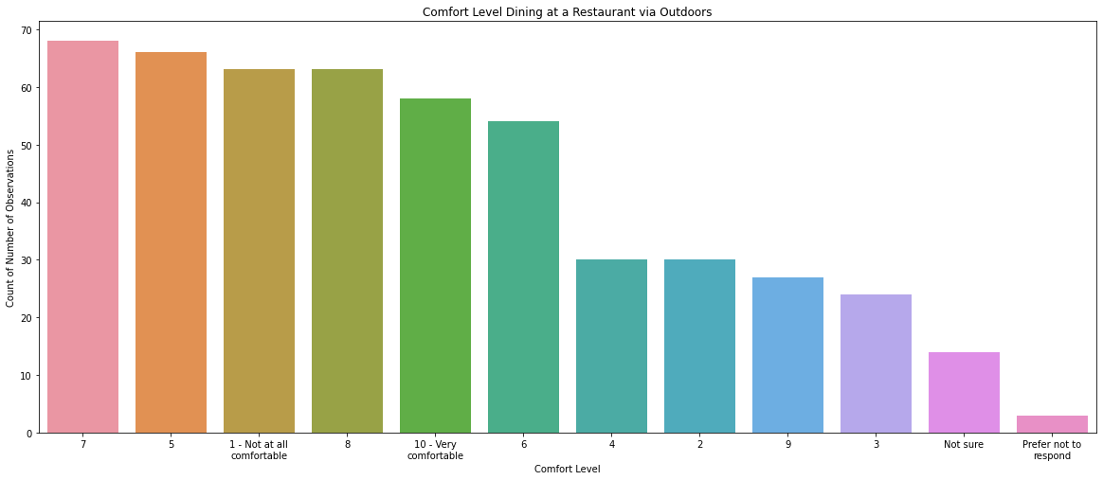
How comfortable would you be dining at a restaurant via Outdoors TODAY?

Slide 12
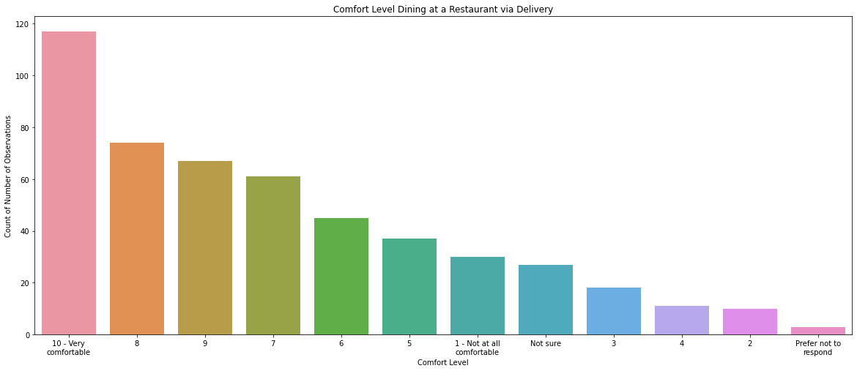
How comfortable would you be dining at a restaurant via Delivery TODAY?

Slide 13
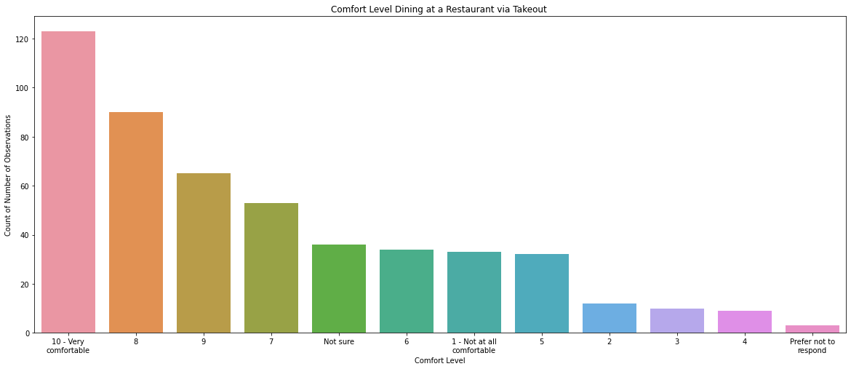
How comfortable would you be dining at a restaurant via Takeout TODAY?

Slide 14
Which of the following would need to be in place at a restaurant for you to feel comfortable dining onsite indoors AND outdoors (patio)?
Face masks worn by all staff
Face masks worn by patrons when not eating
Hand sanitizer available at various points throughout the facility
Hand sanitizer available at every table
Additional cleaning and sanitization
Air filters/purifiers installed at the facility
Ensuring physical distancing (2 meters +) is in place
Other
None of the above – feel safe regardless
None of the above – do not feel safe
Not sure

Slide 15
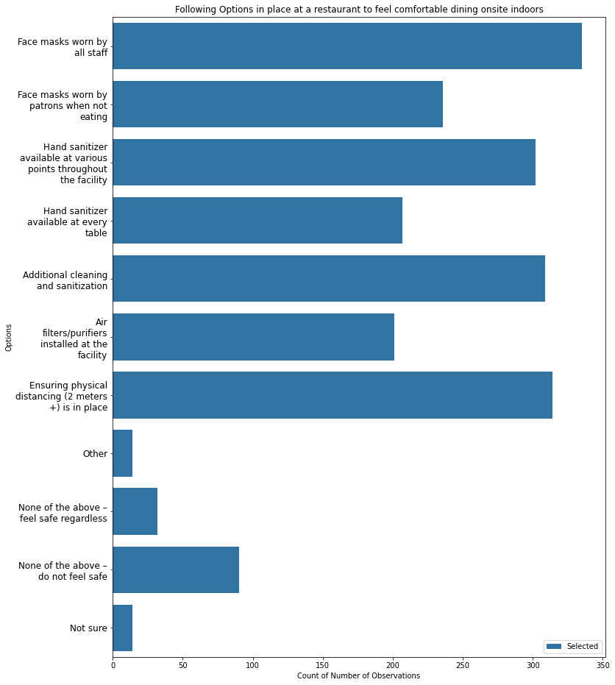
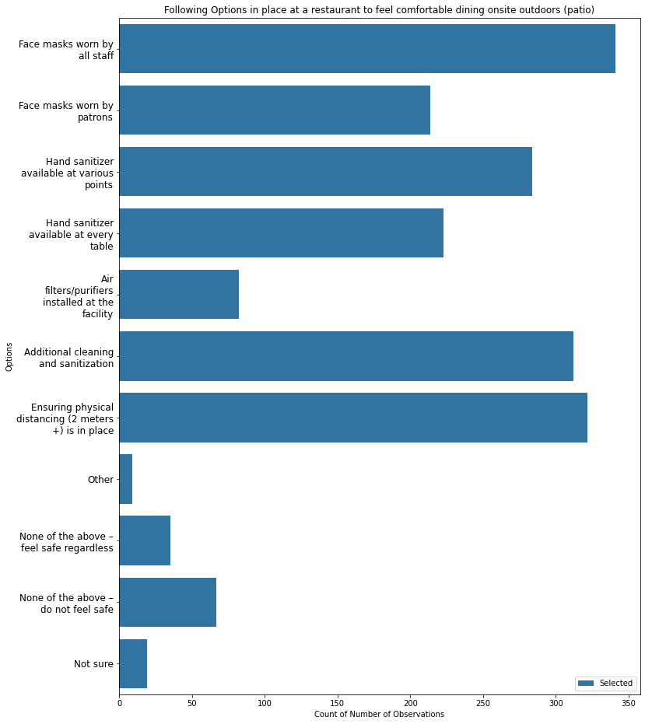
Which of the following would need to be in place at a restaurant for you to feel comfortable dining onsite outdoors?
Which of the following would need to be in place at a restaurant for you to feel comfortable dining onsite indoors?

Slide 16
When was the last time you went to a restaurant to dine-in either inside or on the patio?
Before COVID-19 (March 2020)
In the last week
In the last 2-3 weeks
In the last month
More than a month ago (but since March 2020)
Not sure
Prefer not to respond

Slide 17
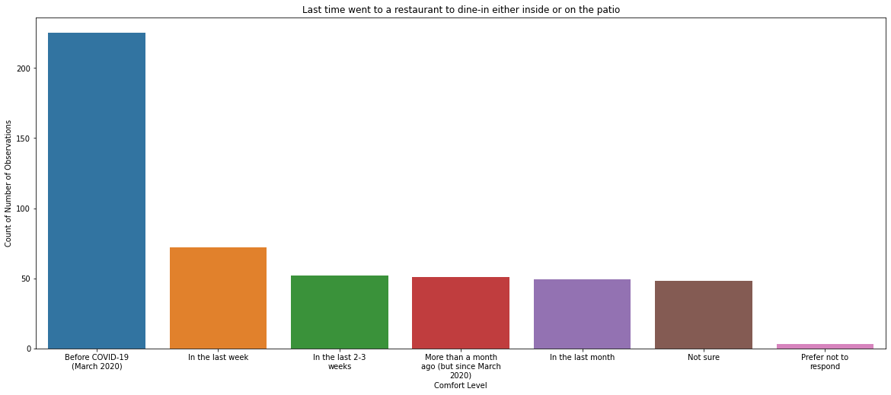
When was the last time you went to a restaurant to dine-in either inside or on the patio?

Slide 18
When was the last time you got take-out or delivery from a restaurant?
Before COVID-19 (March 2020)
In the last week
In the last 2-3 weeks
In the last month
More than a month ago (but since March 2020)
Not sure
Prefer not to respond

Slide 19
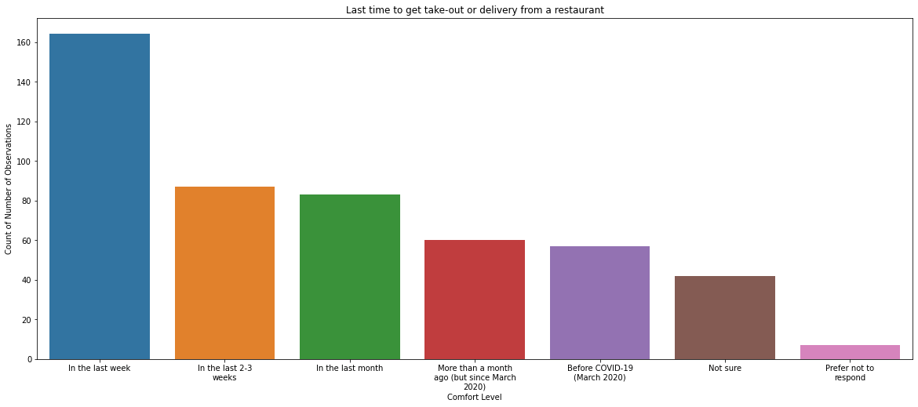
When was the last time you got take-out or delivery from a restaurant?

Slide 20
With the Following, how satisfied have you been with your takeout and/or delivery experience(s) with any restaurant(s) you have frequented since COVID-19 began?
Q1. Cost per person
Q2. Service
Q3. Quality of the food
Q4. Menu options
Q5. Delivery costs
Q6. The time it took to receive your order
Q7. Feeling safe/comfortable when receiving your order
Q8. Overall satisfaction with takeout/delivery experiences

Slide 21
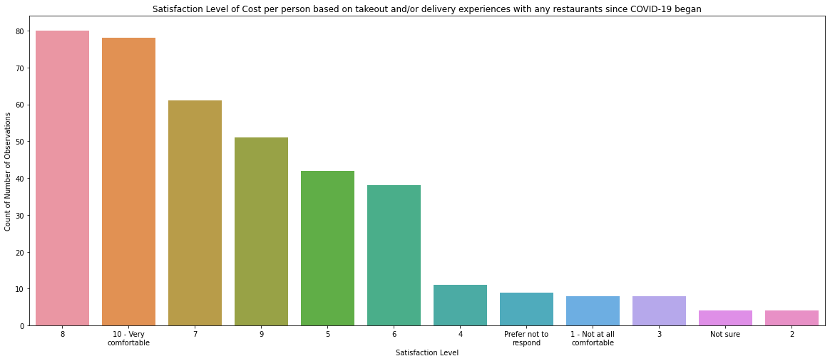
How satisfied have you been with the Cost per person based on your takeout and/or delivery experience(s) with any restaurant(s) you have frequented since COVID-19?

Slide 22
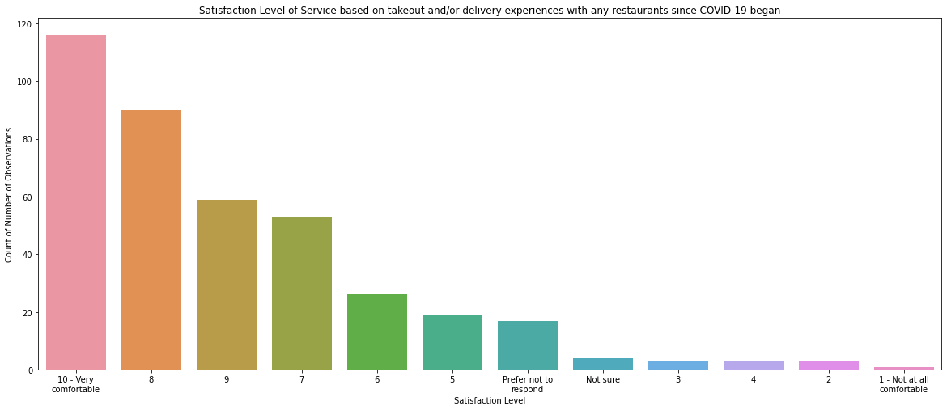
How satisfied have you been with the Service based on your takeout and/or delivery experience(s) with any restaurant(s) you have frequented since COVID-19?

Slide 23
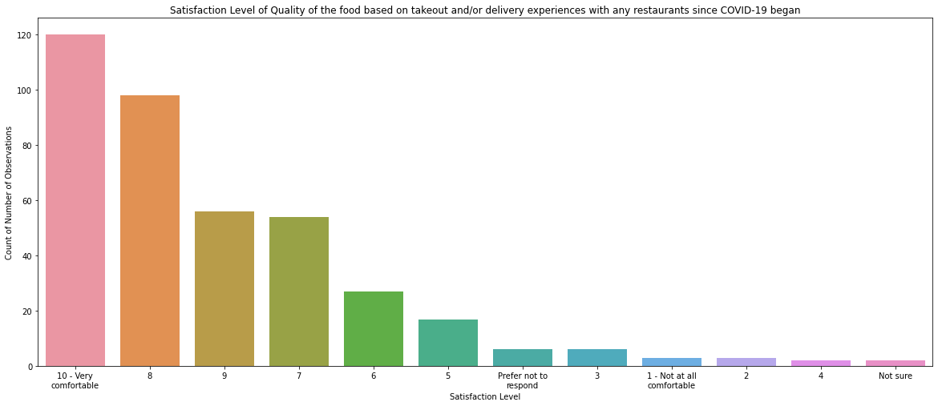
How satisfied have you been with the Quality of the food
based on your takeout and/or delivery experience(s) with any restaurant(s) you have frequented since COVID-19?

Slide 24
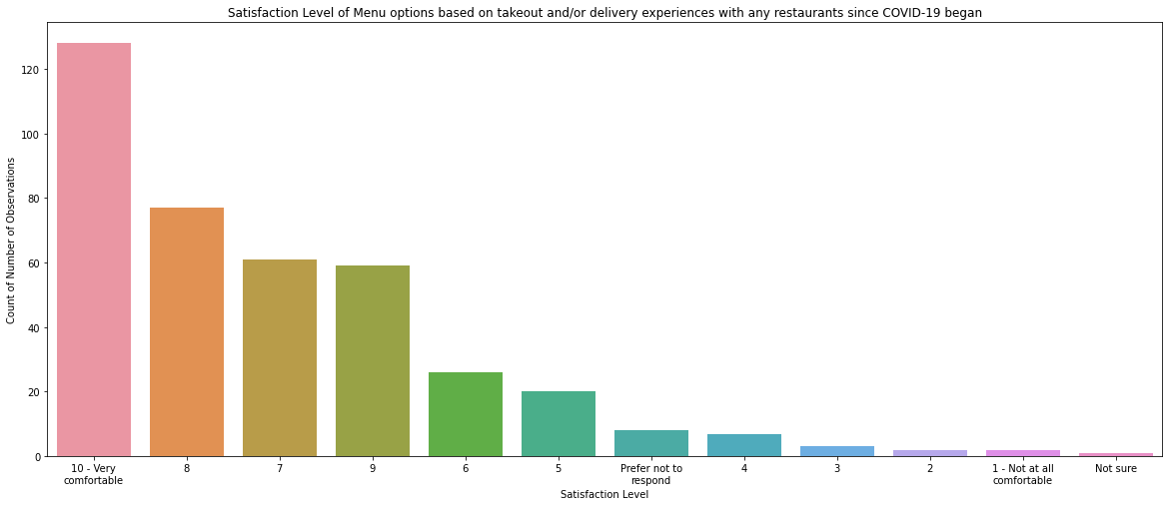
How satisfied have you been with the Menu options
based on your takeout and/or delivery experience(s) with any restaurant(s) you have frequented since COVID-19?

Slide 25
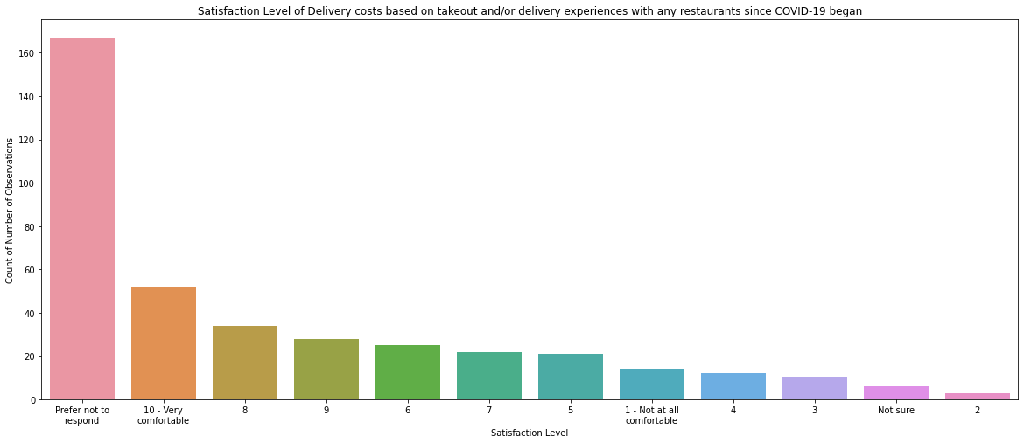
How satisfied have you been with the Delivery costs
based on your takeout and/or delivery experience(s) with any restaurant(s) you have frequented since COVID-19?

Slide 26
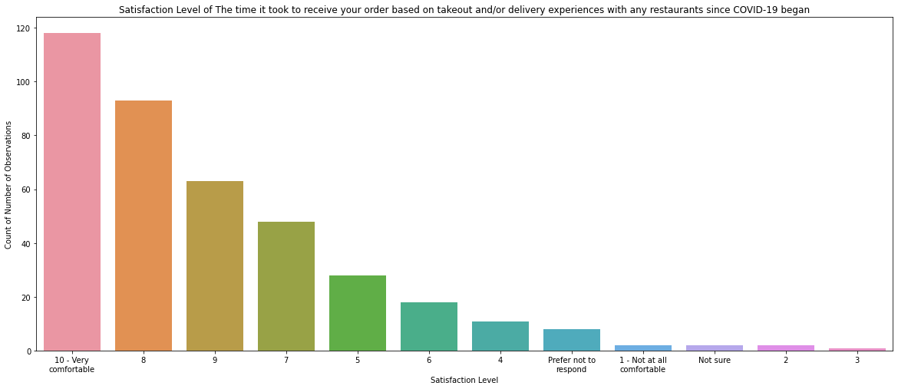
How satisfied have you been with The time it took to receive your order
based on your takeout and/or delivery experience(s) with any restaurant(s) you have frequented since COVID-19?

Slide 27
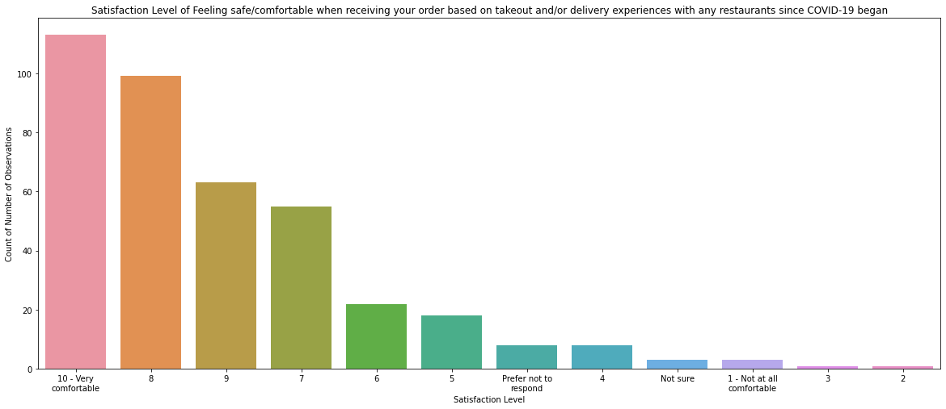
How satisfied have you been with Feeling safe/comfortable when receiving your order based on your takeout and/or delivery experience(s) with any restaurant(s) you have frequented since COVID-19?

Slide 28
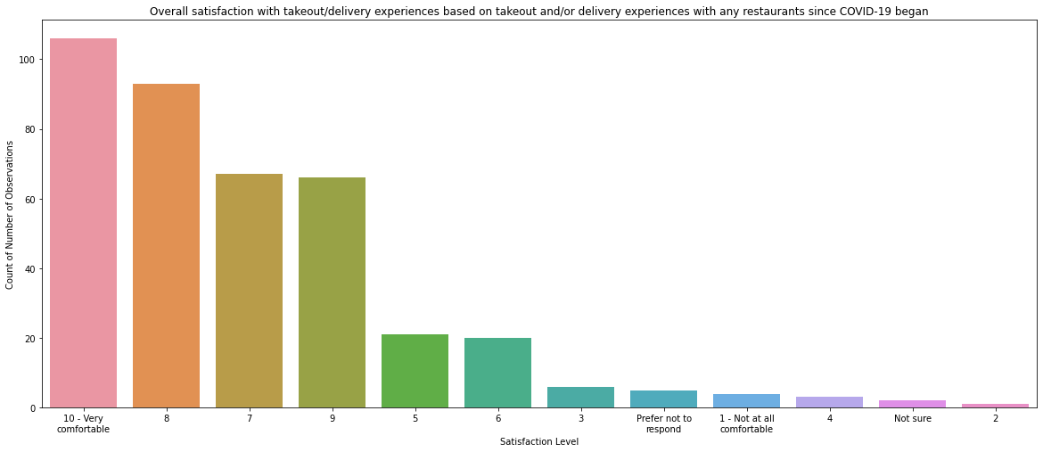
How satisfied have you been with your overall takeout/delivery experiences
with any restaurant(s) you have frequented since COVID-19?

Slide 29
Prior to COVID-19, how important were the following to you when selecting a restaurant…?
Q1. Familiarity
Q2. Well-established
Q3. Trying something new
Q4. Service
Q5. The quality of the food
Q6. The taste of the food
Q7. The atmosphere
Q8. Music
Q9. Outdoor dining/patio
Q10. Wide range of menu
options
Q11. Creativity of the menu
Q12. Sourcing local products
Q13. Value for price paid
Q14. Offer takeout (in-person pickup)
Q15. Offer delivery
Q16. Online reviews
Q17. Recommendation from a family and/or friend
Q18. Coupons and/or discounts available
Q19. Availability of parking
Q20. Focused on cleanliness and safety

Slide 30
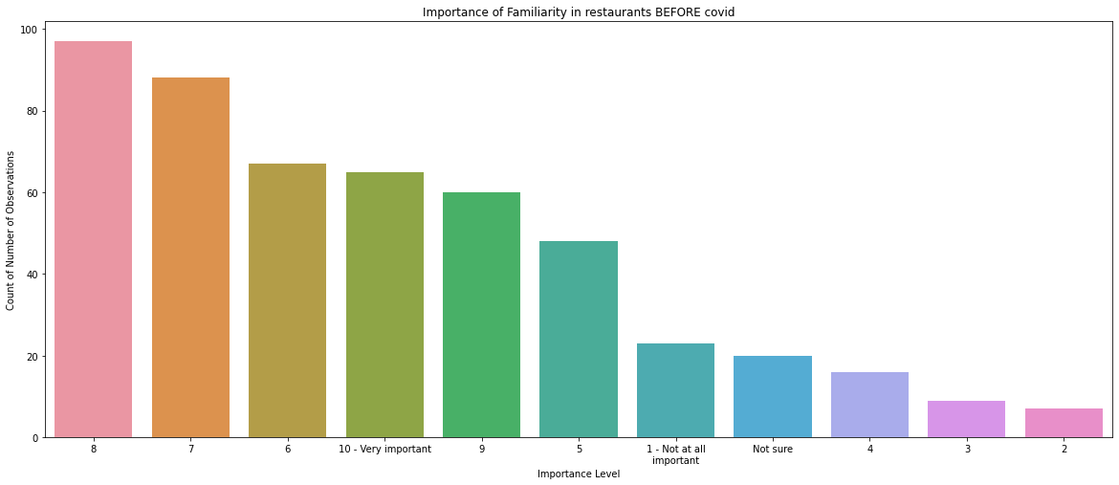
Prior to COVID-19, how important was Familiarity to you when selecting a restaurant?

Slide 31
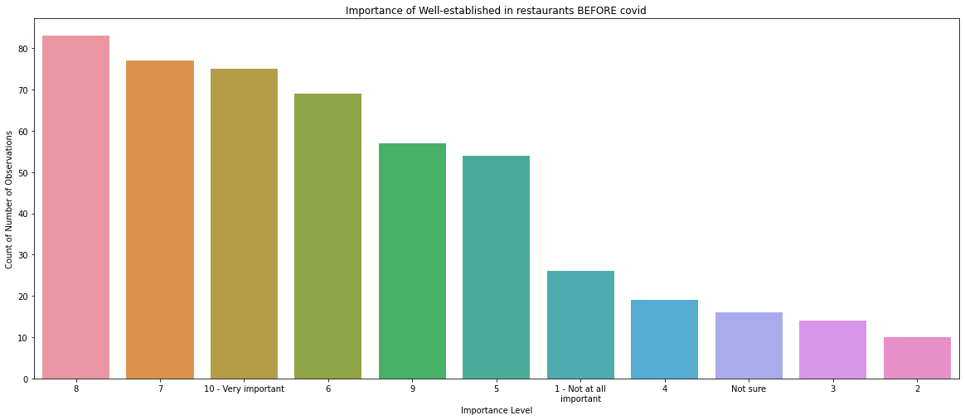
Prior to COVID-19, how important was being Well-Established to you when selecting a restaurant?

Slide 32
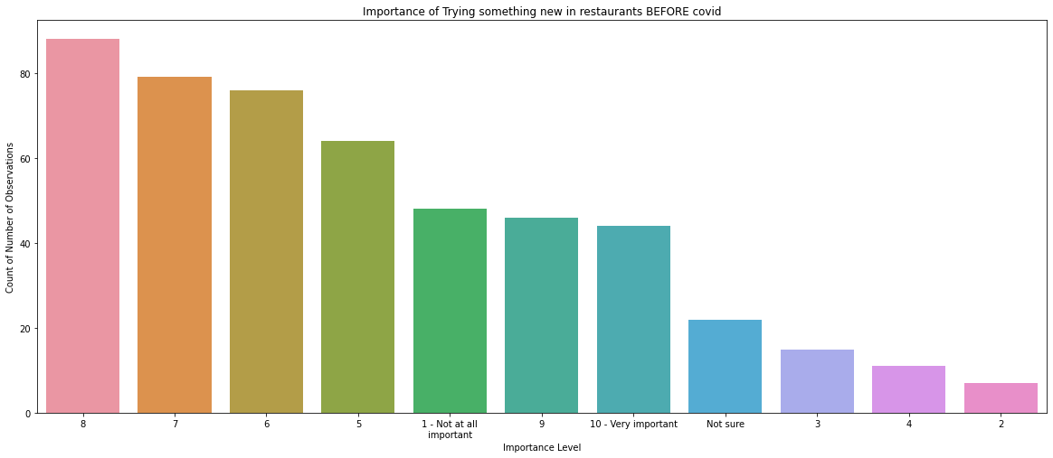
Prior to COVID-19, how important was Trying Something New to you when selecting a restaurant?

Slide 33
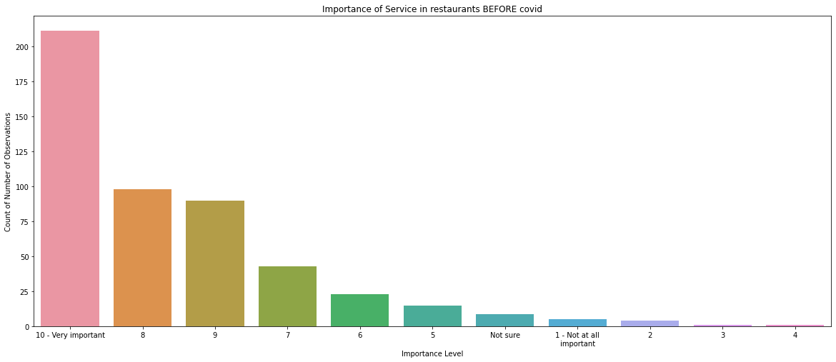
Prior to COVID-19, how important was Service to you when selecting a restaurant?

Slide 34
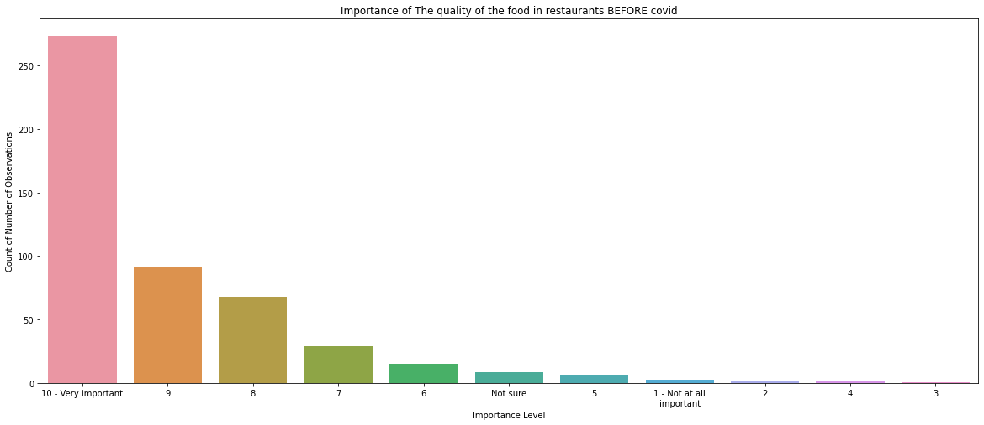
Prior to COVID-19, how important was The Quality of the Food to you when selecting a restaurant?

Slide 35
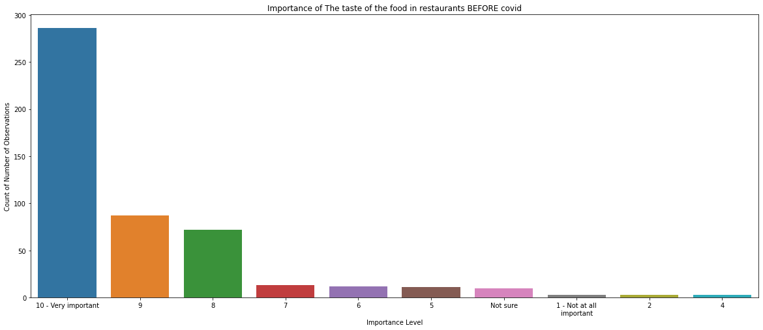
Prior to COVID-19, how important was The Taste of the Food to you when selecting a restaurant?

Slide 36
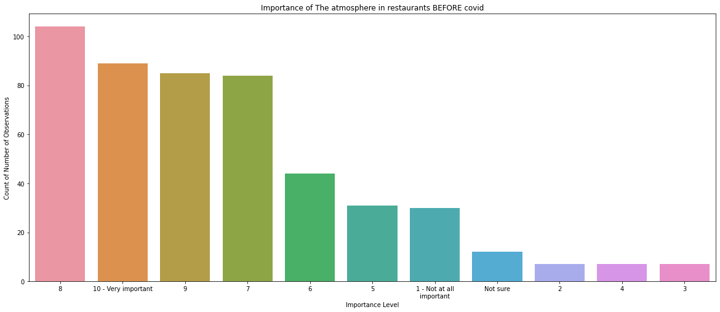
Prior to COVID-19, how important was The Atmosphere to you when selecting a restaurant?

Slide 37
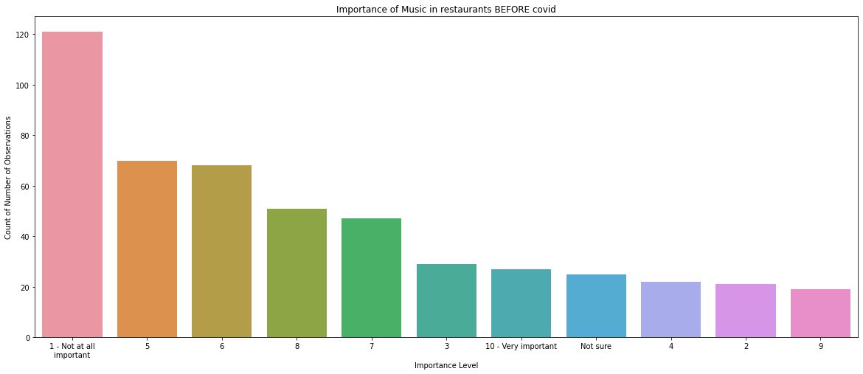
Prior to COVID-19, how important was The Music to you when selecting a restaurant?

Slide 38
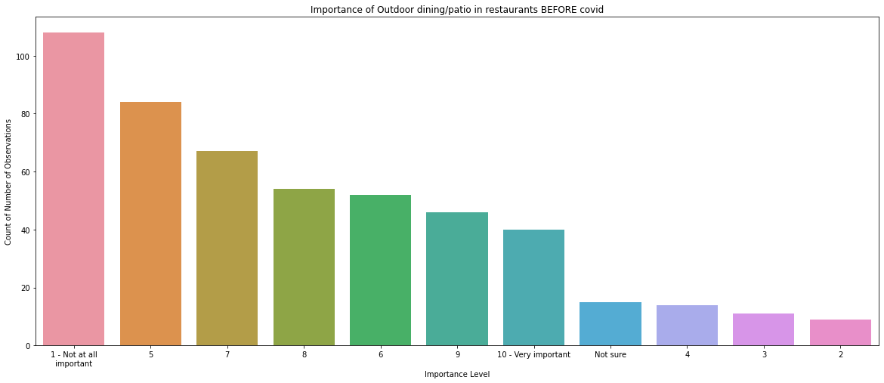
Prior to COVID-19, how important was The Outdoor Dining/Patio to you when selecting a restaurant?

Slide 39
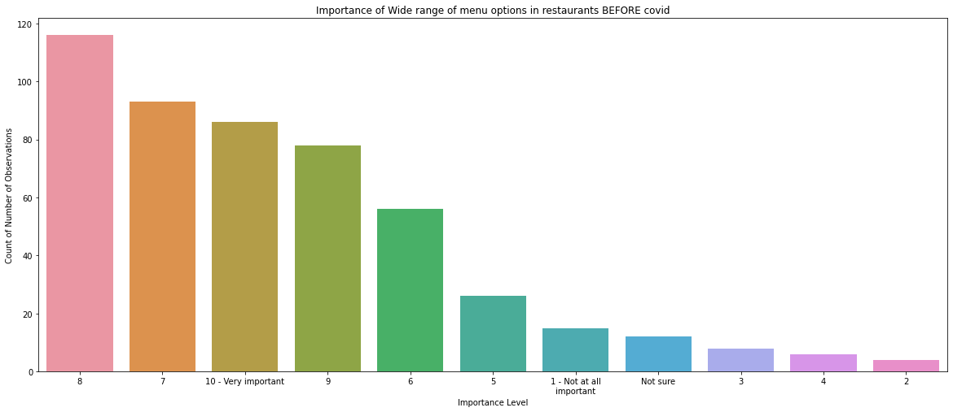
Prior to COVID-19, how important was The Wide Range of Menu Options to you when selecting a restaurant?

Slide 40
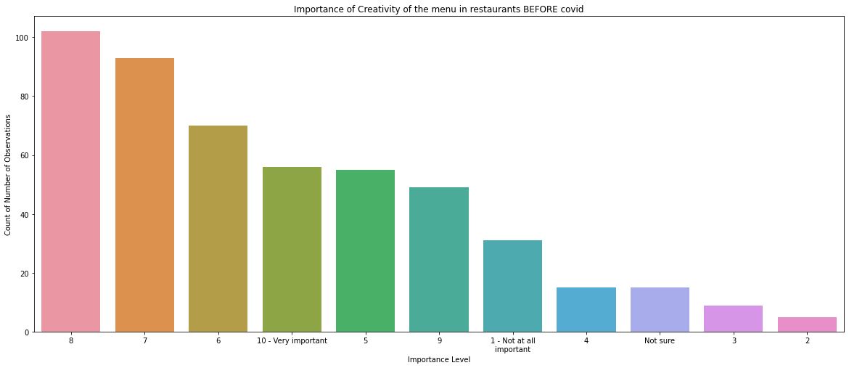
Prior to COVID-19, how important was The Creativity of Menu to you when selecting a restaurant?

Slide 41
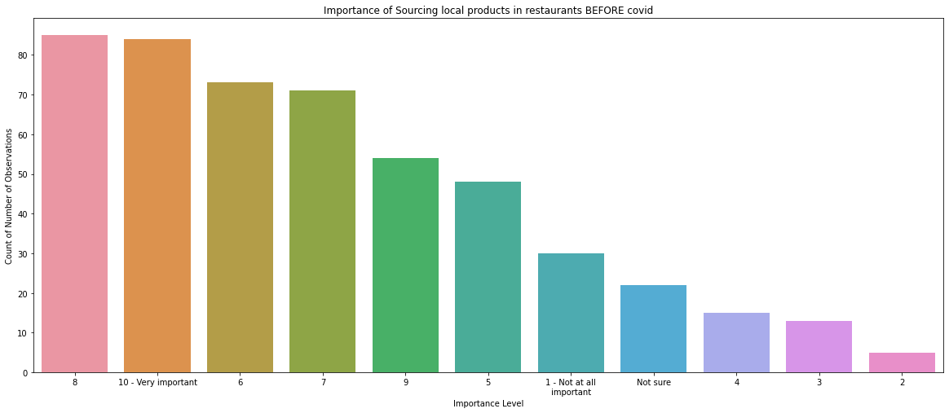
Prior to COVID-19, how important was Sourcing Local Products to you when selecting a restaurant?

Slide 42
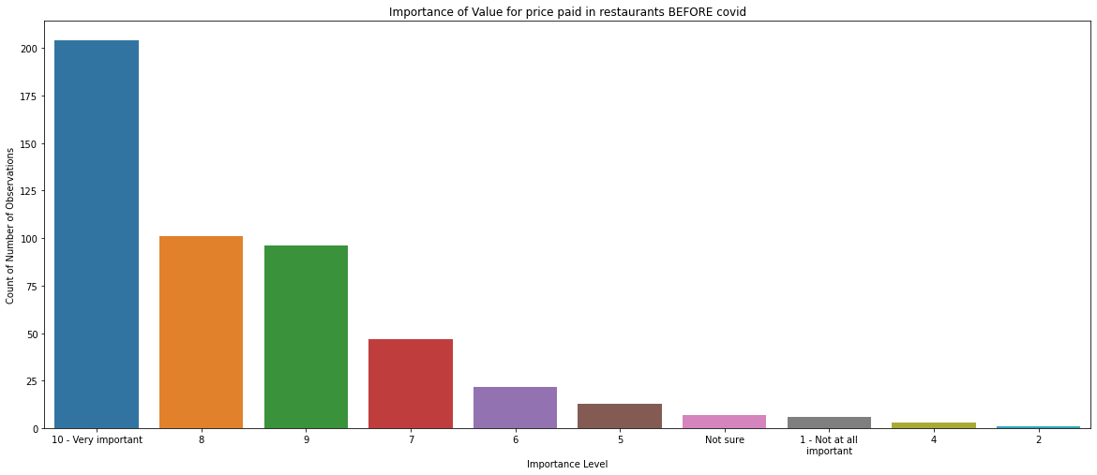
Prior to COVID-19, how important was Value for Price Paid to you when selecting a restaurant?

Slide 43
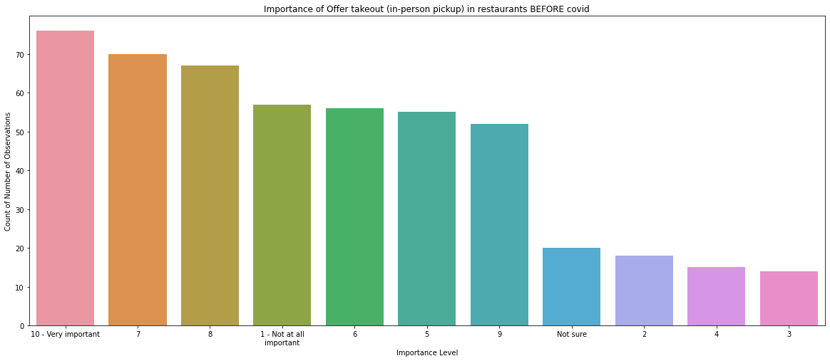
Prior to COVID-19, how important was to Offer Takeout to you when selecting a restaurant?

Slide 44
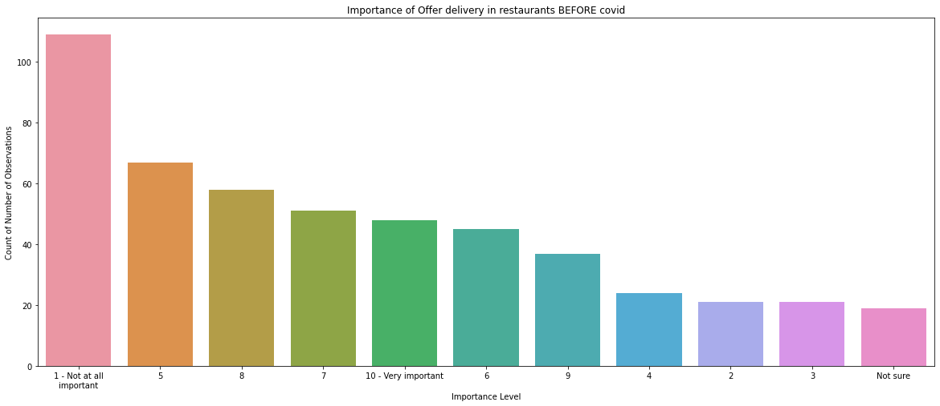
Prior to COVID-19, how important was to Offer Delivery to you when selecting a restaurant?

Slide 45
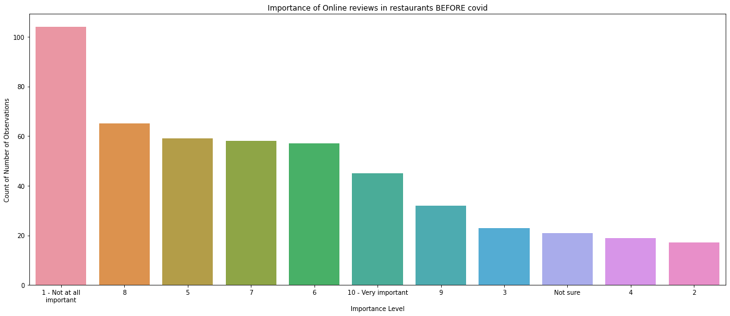
Prior to COVID-19, how important was to Online Reviews to you when selecting a restaurant?

Slide 46
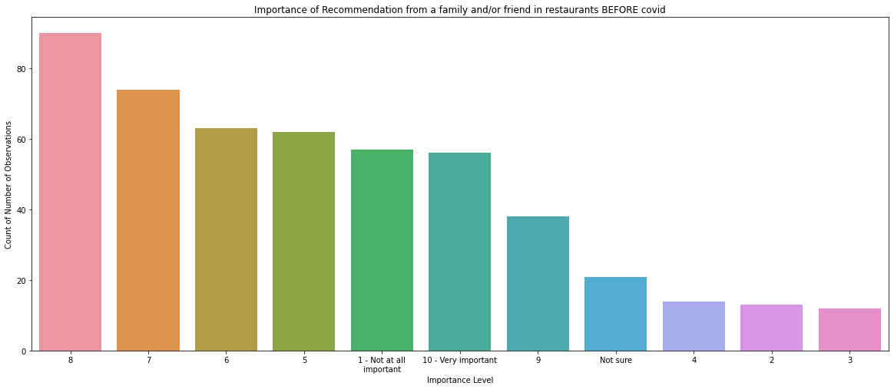
Prior to COVID-19, how important was Recommendation from a Family and/or Friend to you when selecting a restaurant?

Slide 47
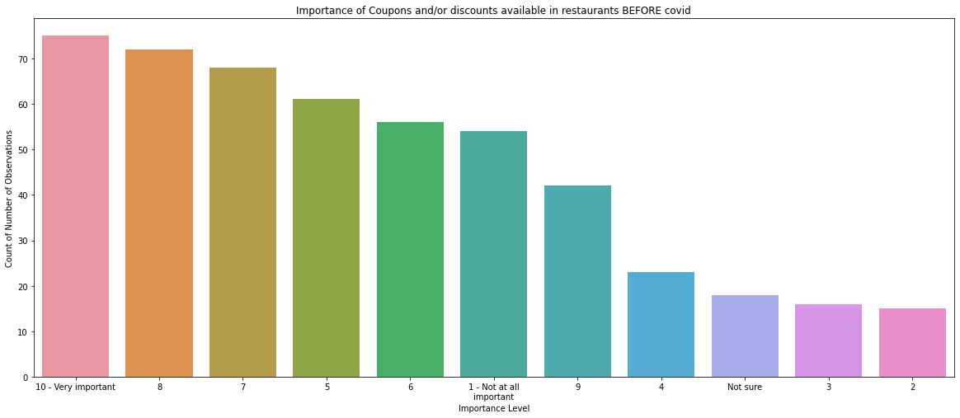
Prior to COVID-19, how important was Coupons and/or Discounts Available to you when selecting a restaurant?

Slide 48
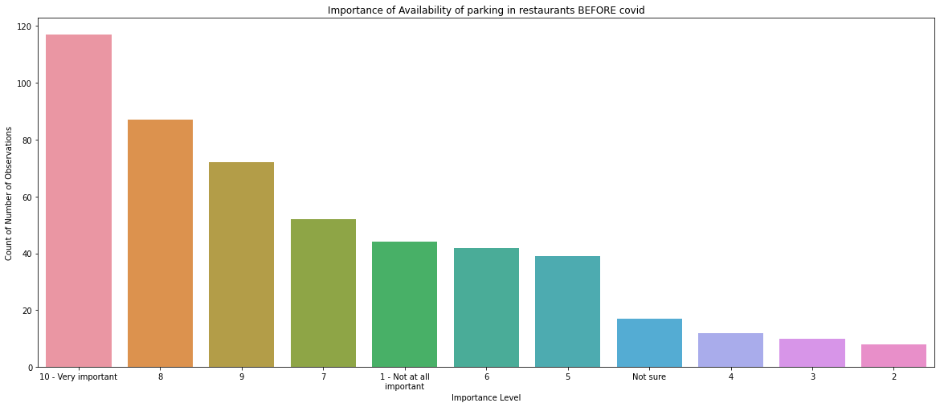
Prior to COVID-19, how important was Availability of Parking in Restaurants to you when selecting a restaurant?

Slide 49
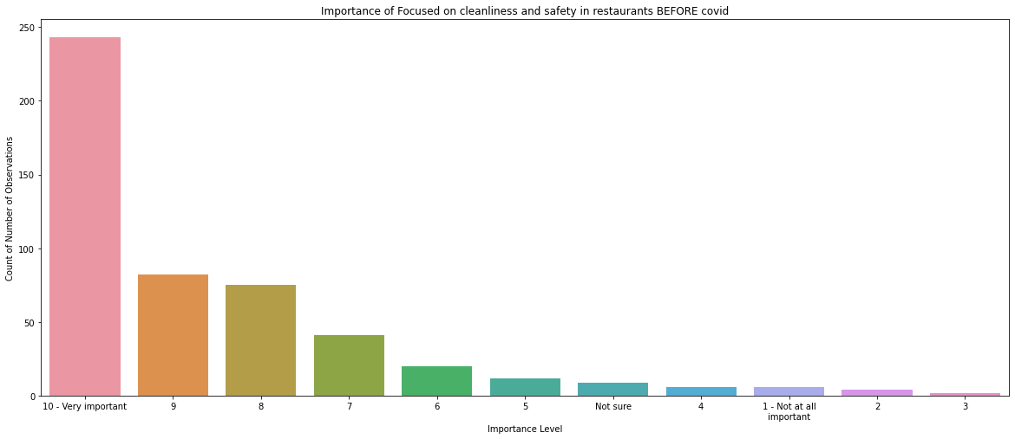
Prior to COVID-19, how important was Focused on Cleanliness and Safety to you when selecting a restaurant?

Slide 50
Which of the following factors have INCREASED importance to you now than pre-COVID when selecting a restaurant, if any?
Familiarity
Well-established
Trying something new
Service
The quality of the food
The taste of the food
The atmosphere
Music
Outdoor dining/patio
Wide range of menu options
Creativity of the menu
Sourcing local products
Value for price paid
Offer takeout (in-person pickup)
Offer delivery
Online reviews
Recommendation from a family and/or friend
Coupons and/or discounts available
Availability of parking
Focused on cleanliness and safety
Other
None of the above
Not sure

Slide 51
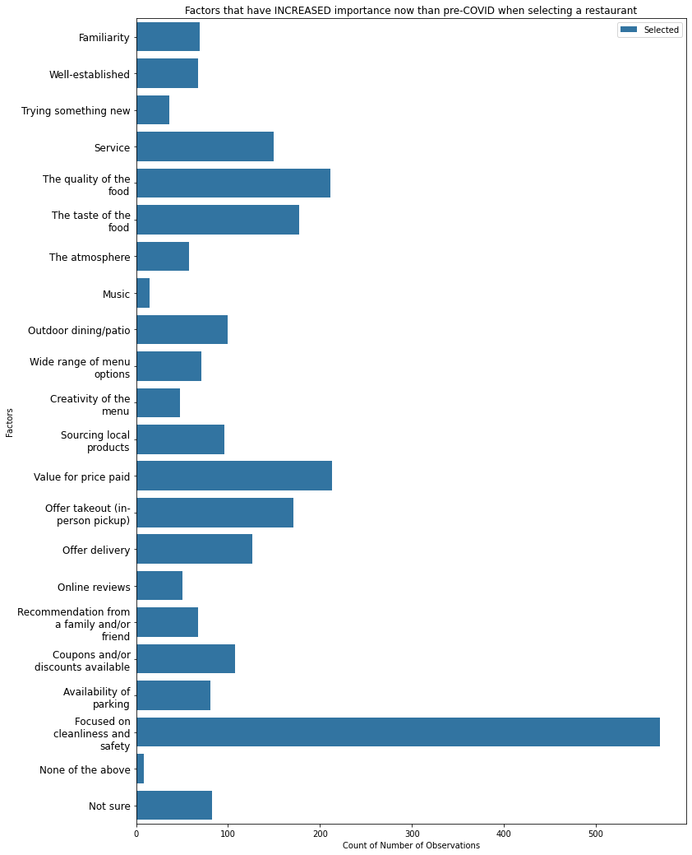
Which of the following factors have INCREASED importance to you now than pre-COVID when selecting a restaurant?

Slide 52
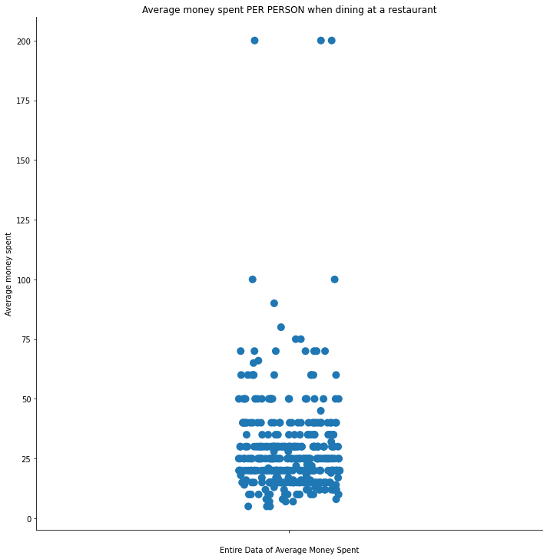
How much do you typically spend per visit, per person, on average when dining at a restaurant?
Mean Average money spent when dining at a restaurant is approximately
$28.64 PER PERSON

Slide 53
Which of the following ways would you prefer restaurants provide additional information to guests regarding health and safety protocols?
Posters/information signage at the restaurant
QR Code printed on the menu
Social media platforms
Email
Pamphlets delivered to your home
Information listed on the restaurant’s website
Other
Do not need to see additional protocols/information
Not sure

Slide 54

Which of the following ways would you prefer restaurants provide additional information to guests regarding health and safety protocols?

Slide 55
What could a restaurant do to help make you feel more comfortable?
Based on the open-ended comments:
If dining AT RESTAURANT:
Wear masks, practice physical distancing, hand sanitization, and offer better air ventilation
Make sure to follow COVID-19 health and safety protocols/guidelines and making them visibly clear by having proper signs in place
If dining AT HOME:
Offer curbside delivery/pick-up
Increase menu options for takeout
Offer discounts

Slide 56
Which of the following best describes your intended actions in terms of returning to “normal” as COVID regulations are lifted?
Not applicable – Have not changed behaviors from pre-COVID
Have already returned to “normal”
Return to what is “normal” for you immediately
Wait until others have returned to “normal”
Wait until family, friends, and/or colleagues have started returning to “normal”
Wait until family, friends, and/or colleagues have returned to “normal” for a period
Hold off if possible; reluctant to return to “normal”
I do not intend to return to my old “normal”
Not sure
Prefer not to respond

Slide 57

Which of the following best describes your intended actions in terms of returning to “normal” as COVID regulations are lifted?

Slide 58
Please indicate whether Option A or Option B best describes you
A: You can’t wait to get back to normal
B: You are embracing the changes that are happening

Slide 59

Please indicate whether Option A or Option B best describes you:
A: You can’t wait to get back to normal
B: You are embracing the changes that are happening

Slide 60
Please indicate whether Option A or Option B best describes you
A: You would prefer to prepare your own meals (i.e., cooking at home)
B: You would prefer to have your meals prepared for you (i.e., pre-packaged, take-out/delivery, restaurant, etc.)

Slide 61

Please indicate whether Option A or Option B best describes you:
A: You would prefer to prepare your own meals
B: You would prefer to have your meals prepared for you

Slide 62
Please indicate whether Option A or Option B best describes you
A: You prefer to dine in at a restaurant
B: You prefer to order take out or delivery

Slide 63

Please indicate whether Option A or Option B best describes you:
A: You prefer to dine in at a restaurant
B: You prefer to order take out or delivery

Slide 64
Which of the following websites do you access once a week or more?
Facebook
Instagram
Twitter
Pinterest
LinkedIn
Snapchat
YouTube
Tik Tok
Google
None – do not access any of the above weekly
Prefer not to respond

Slide 65

Which of the following websites do you access once a week or more?

Slide 66

What is your Age (Based on Year Born)?
Mean age is approximately
56 years old

Slide 67
Which of the following best describes your relationship status?
Married
Co-habitation/common-law
Single, never married
Divorced / Separated
Widowed
Prefer not to respond

Slide 68

Which of the following best describes your relationship status?

Slide 69
Do you have children under the age of 18 living at home?
Yes
No
Prefer not to respond

Slide 70

Do you have children under the age of 18 living at home?

Slide 71
What was the combined annual income for all members of your household before taxes?
Less than $40,000
$40,000-$59,999
$60,000-$79,999
$80,000 -$99,999
$100,000-$149,999
$150,000-$199,999
$200,000-$249,999
$250,000 or more
Not sure
Prefer not to respond

Slide 72

What was the combined annual income for all members of your household before taxes?

Slide 73
What is the highest level of education you have completed?
Less than high school
Some high school
Completed high school
Some college/university
College diploma
University degree
Post-graduate
Prefer not to respond

Slide 74

What is the highest level of education you have completed?

Slide 75
Which of the following best describes you?
Employed full-time
Employed part-time, or consulting
Self-employed professional
Business owner
Stay-at-home parent/Homemaker
Not currently employed but looking for work
Not currently employed and not looking for work
Student
Retired
Other
Prefer not to respond

Slide 76

Which of the following best describes you?

Slide 77
What is your gender?
Male
Female
Other

Slide 78

What is your gender?

Slide 79
How would you classify the area in which you live?
Rural
Suburban
Urban
Not sure
Prefer not to respond

Slide 80

How would you classify the area in which you live?

Slide 81
In which province in Canada are you located?
British Columbia
Alberta
Saskatchewan
Manitoba
Ontario
Quebec
New Brunswick
Nova Scotia
Prince Edward Island
Newfoundland and Labrador
Territories
Prefer not to respond

Slide 82

In which province in Canada are you located?

Slide 83
Further Analysis
Mean Average Money Spent PER PERSON when dining at a restaurant between:
Provinces in Canada
Types of Area Classification (Urban, Suburban, Rural)
Household Income Classes

Slide 84

Mean Average Money Spent PER PERSON when dining at a restaurant between Provinces in Canada

Slide 85

Mean Average Money Spent PER PERSON when dining at a restaurant between Types of Area Classification

Slide 86

Mean Average Money Spent PER PERSON when dining at a restaurant between Household Income Classes

Slide 87
Main Takeaways
Since COVID-19, people ordered takeout/delivery more frequently than dining onsite at restaurant
People were more comfortable ordering more takeout/delivery from restaurant as opposed to dining onsite since COVID-19
People requested more sanitization, face masks, physical distancing, air purifier/ventilations to feel safe while dining onsite at restaurant during COVID-19
People seemed to be mostly satisfied with overall takeout and/or delivery experience
Nowadays, people placed more importance in cleanliness/safety, value of price paid for, service, quality/taste of food, and offering more takeout/delivery
Mean Average money spent when dining at a restaurant is approximately $28.64 PER PERSON
Most people requested information about health and safety protocols to be provided on restaurant’s website or as a postage onsite
Most people prefer to prepare their own food or order takeout/delivery from restaurant
Based on survey data, most people access either Facebook, Google and/or YouTube sites

Slide 88
Main Takeaways (continued…)
Regarding demographics of people who participated in the survey data:
More females over males participating in survey data
Mean age in survey data is approximately 56 years old
Most household incomes in the survey data lies around $0 to $150,000
Most people in the survey data do NOT have kids under the age of 18
Majority of people in the survey data are either employed full time or are retired
Majority of people in survey data live in urban or suburban areas/regions
Most people in survey data live/reside in Ontario
Most money PER PERSON spent dining at restaurants occur in urban or suburban areas and in populated/expensive cities in provinces such as Ontario, British Columbia, Alberta, etc.

Slide 89
Recommendations
Restaurants should focus more on increasing menu options for takeout/delivery over onsite dining
Advertise their business online through sites such as Facebook, Google, and YouTube to get more exposure
Provide health and safety protocols through their restaurant website or as postage onsite
Focus more on cleanliness/safety, quality of food and service, and offering more takeout/delivery
Offering discounts or promotions on takeout/delivery
Reduce or minimize cost of onsite dining and shift that budget on takeout/delivery
Expand business in larger urban and suburban places

Slide 90
THANK YOU!

